Slide 1
Front End Engineering-I Project
Team Details:
Bhavika Goyal - 2210990219
Bhavika Arora - 2210990220
Bhavika Chopra - 2210990221
Bhavleen Singh - 2210990222
Faculty Coordinator: Ms. Preeti Saini
:
Chitkara University Institute of Engineering and Technology,
Chitkara University, Punjab

Slide 2
Table of Contents
Introduction
Problem Statement
Technical Details
Key Features
Project Highlights
Bonus Feature(optional)
Conclusion
References/Links used

Slide 3
Introduction
Countdown Timer
Team members’ :
Bhavika Goyal - 2210990219
Bhavika Arora - 2210990220
Bhavika Chopra - 2210990221
Bhavleen Singh – 2210990222
Purpose :
A countdown timer project in HTML typically involves creating a digital clock that counts down from a specified time interval to zero. The purpose of this project could vary, but it is often used to create a sense of urgency or to provide a visual cue for an upcoming event or deadline.
Goals:
Creating a functional and accurate timer. It should be able to accurately count down from the specified time interval to zero and trigger an event or message when the time is up.
Customizing the design. It can be styled to fit the aesthetic of the website or application it is being used on. This may involve choosing the font, color scheme, and overall layout of the timer.
Adding interactivity. Depending on the requirements, the timer can be made interactive by allowing users to pause, restart or set a new time interval.

Slide 4
Problem Statement
The problem that this HTML project on a countdown timer aims to solve is to provide a clear and accurate way for users to track the time remaining until a specific event or deadline. By creating a visually appealing and responsive countdown timer, the project aims to make it easy for users to see at a glance how much time is left, without having to perform any calculations or consult an external source. Additionally, by allowing users to specify the end date and time themselves, the project aims to provide a customizable tool that can be used for a wide range of purposes, from tracking the time until a product launch to counting down to a personal event like a birthday or wedding.

Slide 5
Technical Details
HTML: The basic structure of the word counter HTML project is built using HTML. HTML is a markup language used to create web pages.
CSS: CSS is used to style the HTML elements of the word counter HTML project. It is used to define the appearance of the web page, including font size, color, and layout.
JavaScript: JavaScript is used to provide interactivity and functionality to the word counter HTML project. It is used to count the number of words entered into the text area, update the word count in real-time, and perform other functions like resetting the word count.
Regular Expressions: Regular expressions are used to split the text entered into the text area into individual words. Regular expressions provide a powerful way to match patterns in text.

Slide 6
Key Features
The countdown timer is displayed in a clear and visually appealing format, such as "Days : Hours : Minutes : Seconds". The display is easy to read and understandable, and includes labels or icons to indicate which units of time are being displayed.
The countdown timer is customizable in terms of its appearance and styling, so that it can be integrated into a wide range of websites and applications. This can be achieved using CSS, which can be used to adjust the color, size, and positioning of the timer display.
The countdown timer is updated in real-time, without requiring the page to be refreshed. This can be achieved using JavaScript, which can periodically check the current time and update the timer display accordingly.
The countdown timer is designed to work well on both desktop and mobile devices, with a responsive layout that adjusts to different screen sizes and orientations.

Slide 7
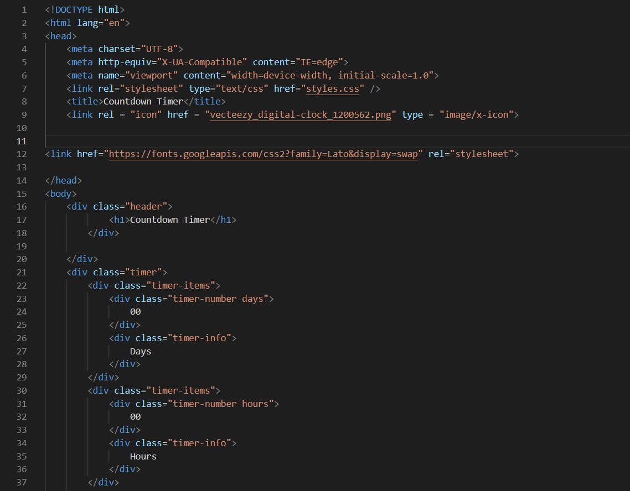
Project Highlights
Html code:

Slide 8
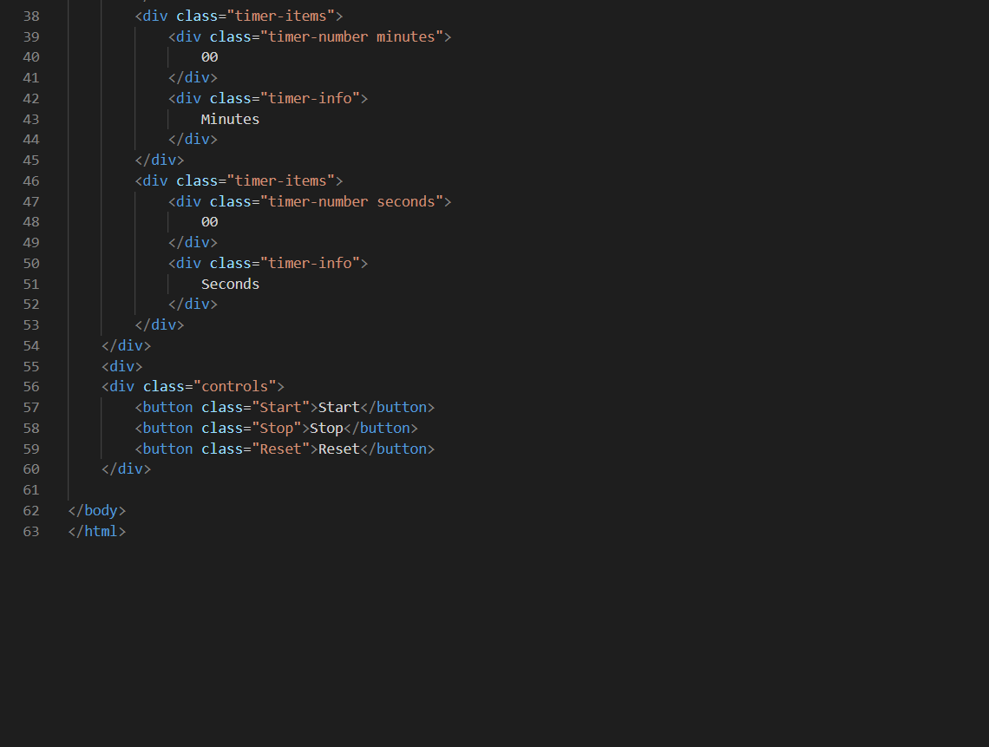
Project highlights

Slide 9
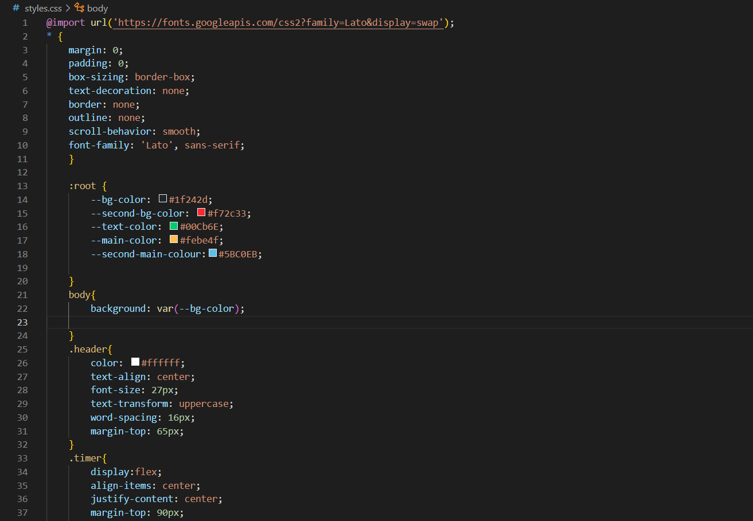
Project highlights
CSS code:

Slide 10
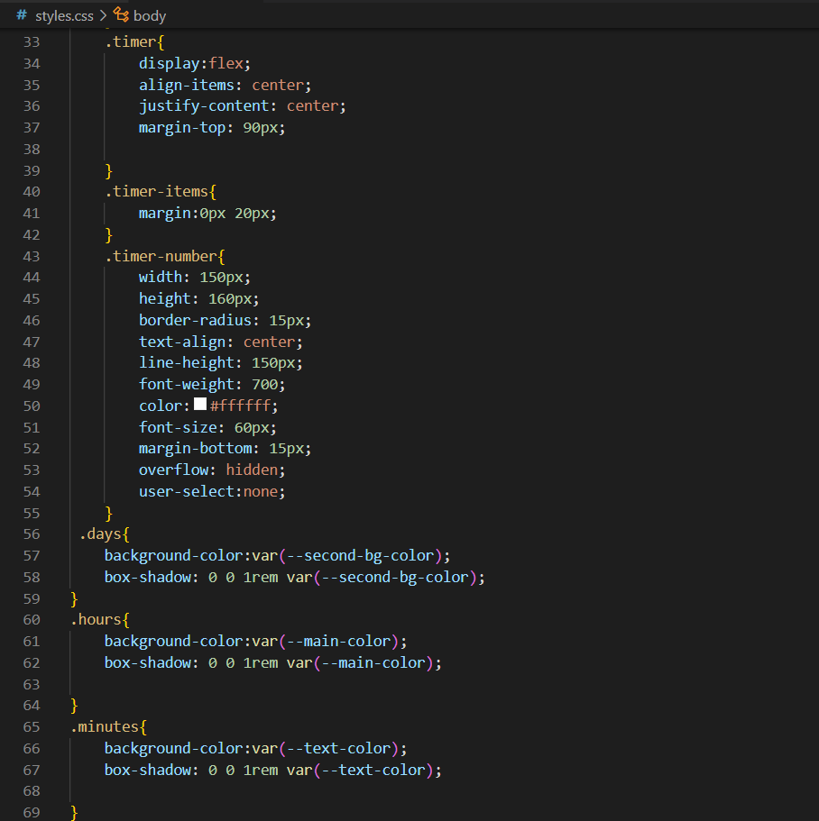
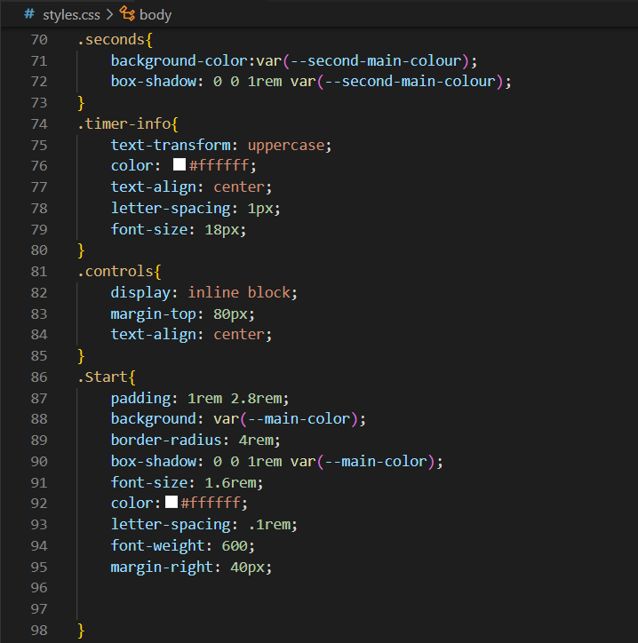
Project highlights

Slide 11
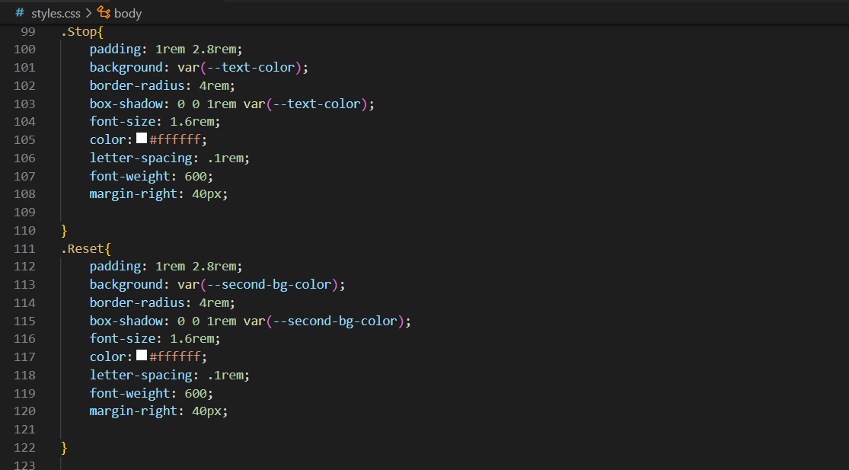
Project highlights

Slide 12
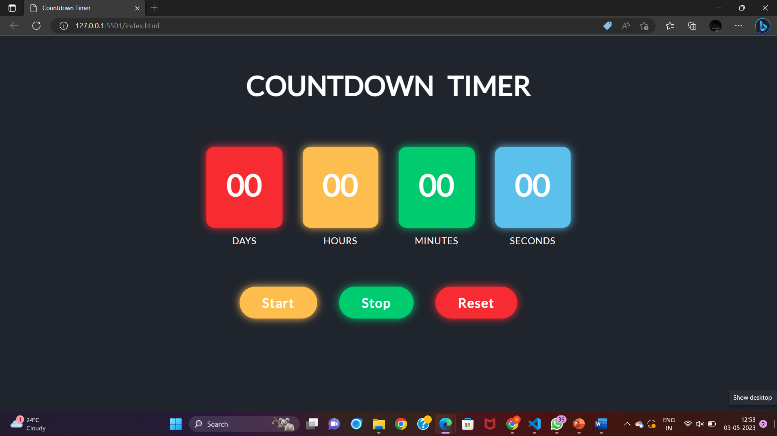
Project highlights
Output:

Slide 13
Conclusion
Key points:
Use HTML and CSS to create a visually appealing and easy-to-understand display for the countdown timer. Consider using labels, icons, or other visual cues to indicate which units of time are being displayed.
Use CSS to adjust the appearance and styling of the countdown timer, so that it integrates seamlessly into your website or application.
Use JavaScript to periodically check the current time and update the countdown timer display accordingly.
Test the countdown timer in a variety of browsers and devices, and solicit feedback from users to identify any areas for improvement.
Takeaways:
Improved understanding of HTML, CSS, and JavaScript.
Enhanced problem-solving and critical thinking skills.
Increased creativity and design skills.
Improved collaboration and communication skills.

Slide 14
References/Links used
https://youtu.be/AbmVRYZ_AwE
https://youtu.be/CeLu1vSuaTQ

Slide 15


